Slide 1


Impact of Solder Voids on Power Device Thermal Impedance Using Transient System Analysis
Nathan Carlson
Dept. of Electrical and Computer Engineering
The University of Alabama
ncarlson@crimson.ua.edu
Dr. Nicholas Baker
Dept. of Electrical and Computer Engineering
The University of Alabama
nbaker2@crimson.ua.edu

Slide 2
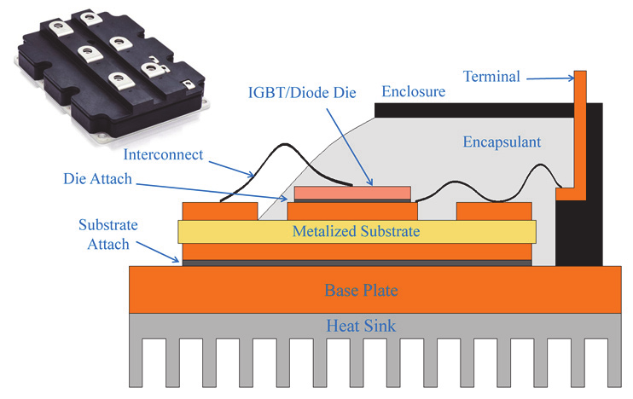
What is Die-Attach?
Die-attach: secures the semiconductor device to the external structure and also conducts main current
Must withstand high temperatures and mechanical stress while also conducting heat and electric current
This is a common point of fatigue failure in power devices
Die-attach can be solder, sinter, or other materials, but we will focus on solder.
Example power module stack [1]

Slide 3
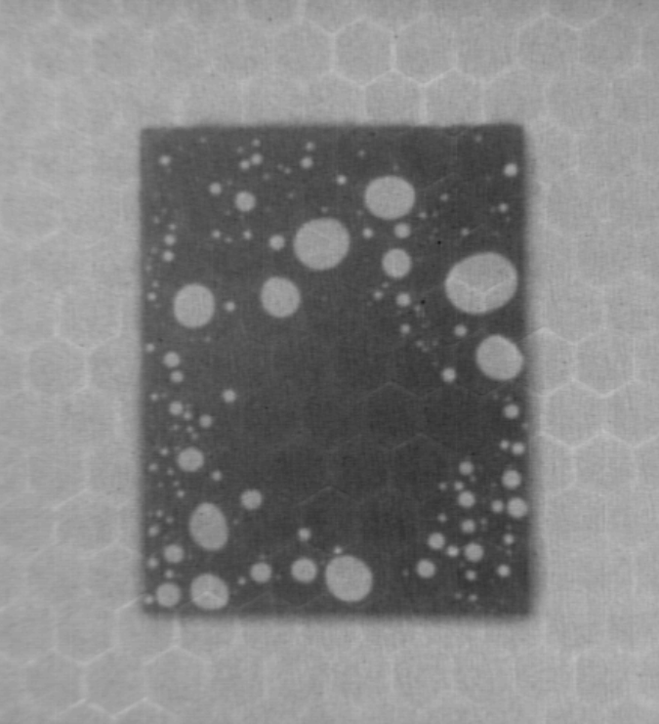
What are Solder Voids?
Solder voids are small pockets that form in the solder during reflow.
Primarily caused by outgassing of organic compounds in the solder flux, but poor wetting also contributes.
Commonly measured as a “void percentage”, which is the ratio of voided solder area to total area
Can be reduced using vacuum solder machines or other methods
X-ray image of solder voids underneath a power diode.

Slide 4
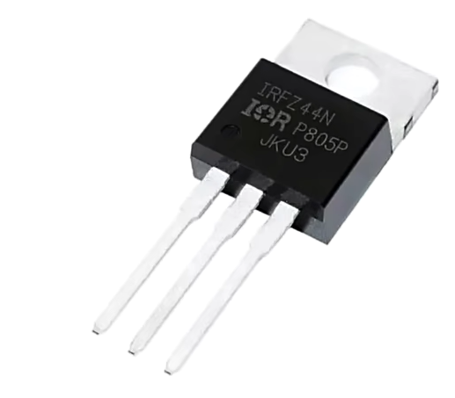
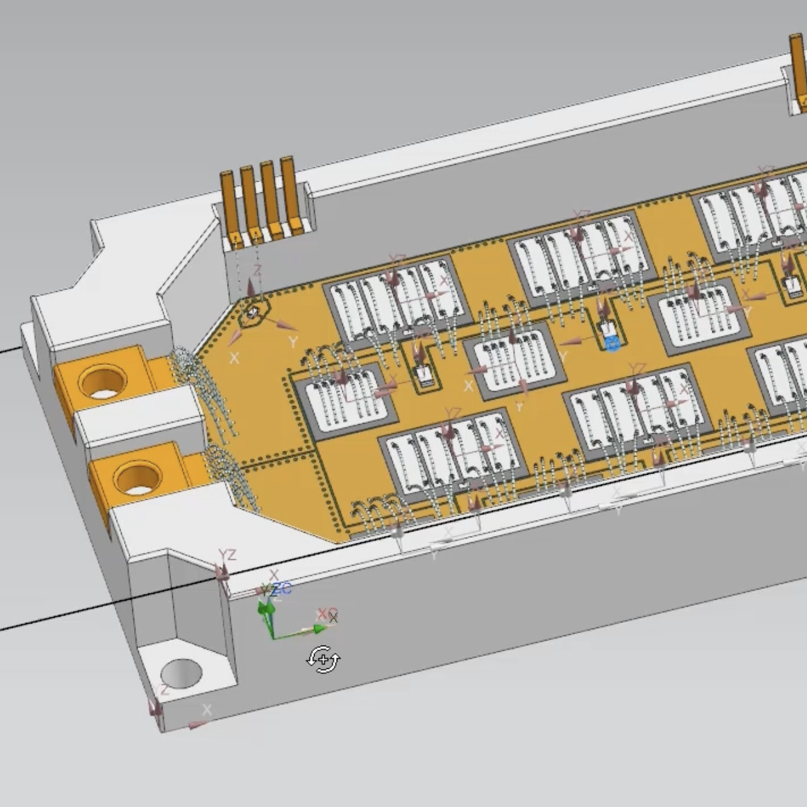

Main Problem: Vacuum Soldering = $$$
Applications where vacuum soldering may be unattractive:
Mass production of discrete transistors
Research labs and prototyping
What impact do voids have?
How does this affect the decision to use vacuum soldering?

Slide 5
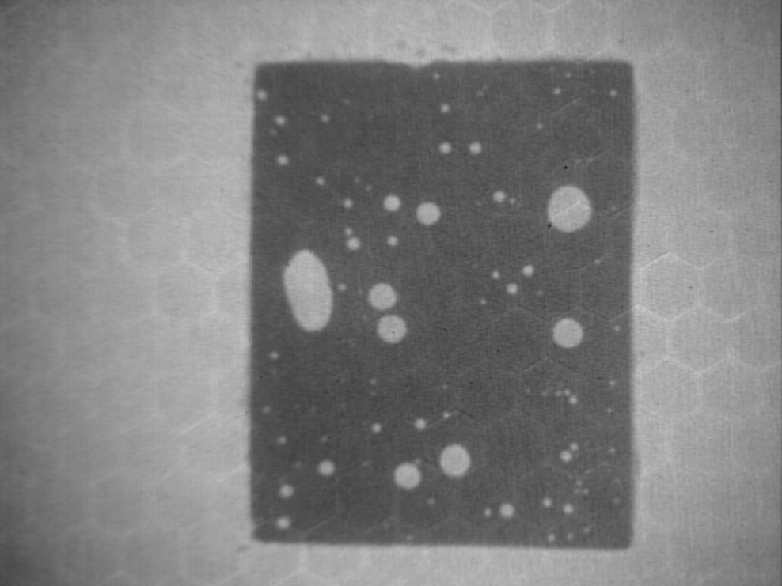
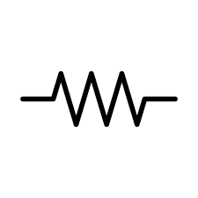


What We Measured
Solder voids
-------------------- Versus --------------------
Thermal Impedance
Reliability
Fatigue Damage

Slide 6
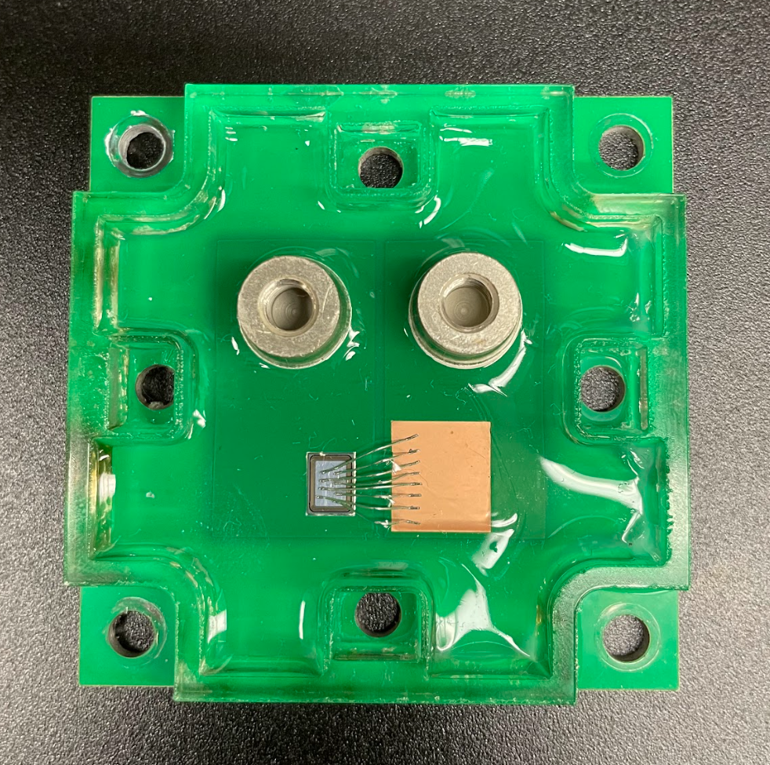
Sample Creation
25 Samples
Diode Information:
Two different SAC 305 solder paste (Indalloy 256 and Chipquik SMD291SNL10T4)
‘X’ shaped stencil with 100um thickness
Reflow in convection oven: Manncorp MC 301
Three reflow profiles used (see appendix)
PCB surface metallization: bare Cu
Model: VS-4FD198H06A6BC
Size: 5.03mm X 3.35mm
Rated current: 50A

Slide 7
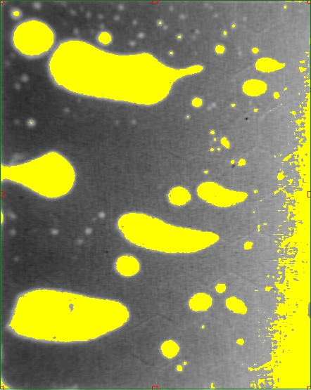
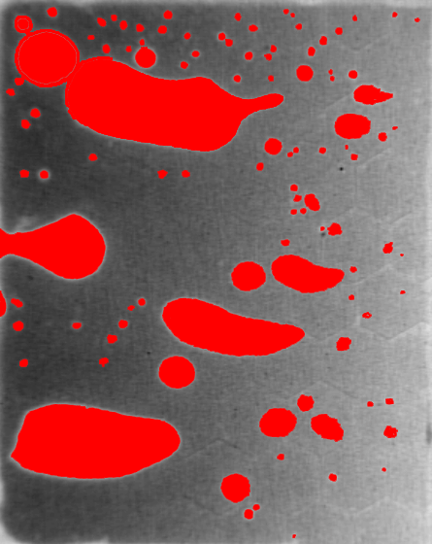
Void Percentage Calculation
Fill Tool Method
Capture Xray image of solder
Import into Photoshop
Use the fill tool to select voided areas*
Calculate the number of red pixels vs total pixels
Void selection with Threshold method.
Traditional threshold method susceptible to chip tilt errors
*Fill Tool Threshold settings: 35, 27, 20, 13, 5. Use high settings for large voids and voids with highly contrasted edges.
Selection of voided areas using Fill Tool method.

Slide 8

Part 1:
Thermal Impedance

Slide 9
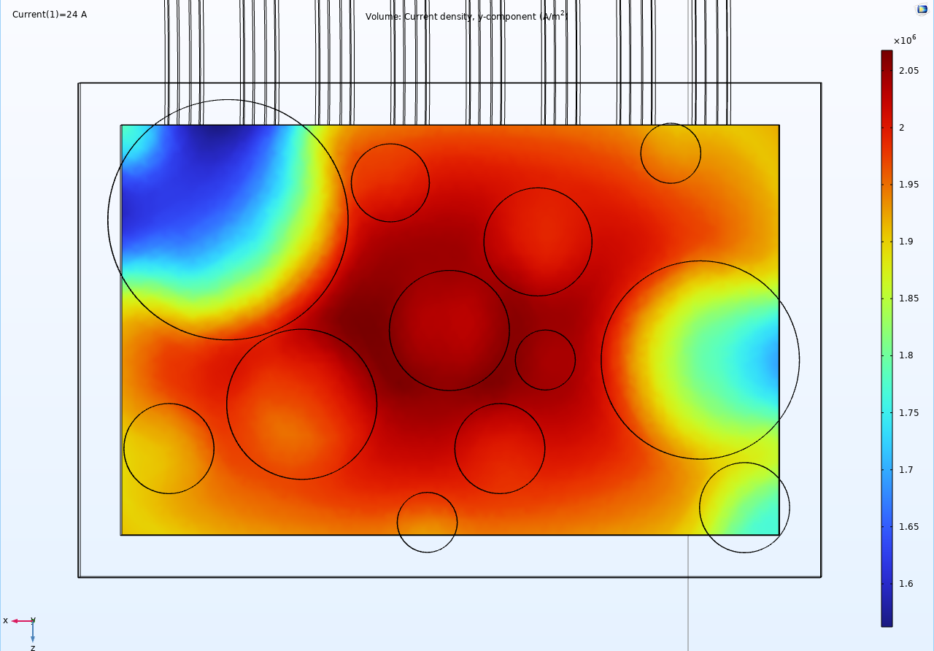
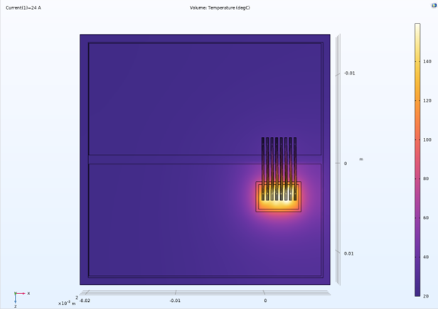
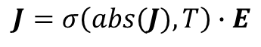
Finite-Element Simulation of Diode
Diode Electro-Thermal Model
Mesh Refinement
Used IV curve of diode at various temperatures to calculate a lookup table for effective junction conductivity vs local temperature and local current density
Used a “weak contribution” which allows Comsol to solve self-recurrent PDEs.
Started with 2 meshes: high-res and low-res. Continually refined low-res mesh until it produced results within 1% of the high-res version.
Diode junction vertical current density (steady-state, mesh A13, 40% void)
$$J=σ\left(abs(J), T\right)∙E$$
Entire model Temperature (degC, steady-state, mesh A13, 40% void)

Slide 10

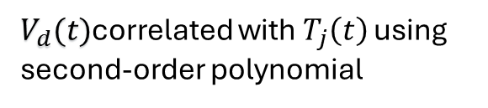
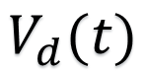

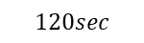
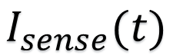
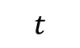

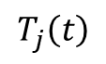
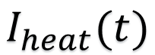
Thermal Test Setup
$V_{d}(t)$correlated with $T_{j}\left(t\right)$ using second-order polynomial
$$V_{d}(t)$$
+ -
Example Cooling Curve
$$T_{j}\left(t\right)$$
$$I_{heat}(t)$$
$0$ $120sec$
$$I_{sense}(t)$$
$$50 mA$$
Tested currents: 5, 10, 15, 20, 22, 24A
$0$ $120sec$
$$t$$
$$120sec$$

Slide 11
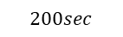


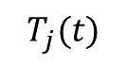
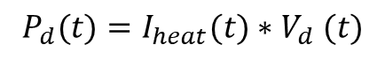
Postprocessing: Extraction of Heating Curve
Goal: Given a cooling curve, calculate the heating curve
Assumption 1
Thermal system is linear and time-invariant (LTI)
Assumption 2
System reaches steady-state within 120 seconds
$$P_{d}(t)=I_{heat}(t){∗V}_{d}(t)$$
Cooling
Thermal System
$$T_{j}(t)$$
$200sec$
$${\hat{P}}_{d}\left(t\right)=P_{i}−P_{d}\left(t+120\right)$$
Heating
Thermal System
$${\hat{T}}_{j}\left(t\right)=T_{j}\left(120\right)−T_{j}\left(t+120\right)+T_{env}$$
$0$

Slide 12

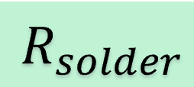

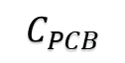
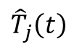
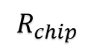
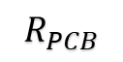
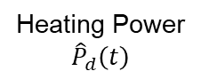
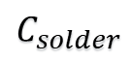
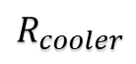
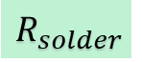
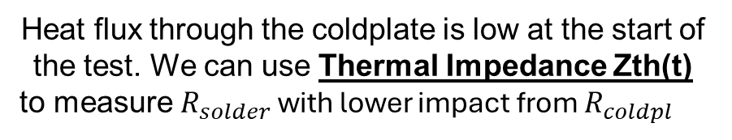
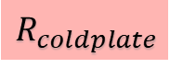
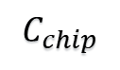
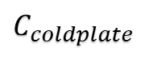
Why We Can’t Measure Rth Directly
$${\hat{T}}_{j}\left(t\right)$$
$$R_{chip}$$
$$R_{solder}$$
$$R_{PCB}$$
$$R_{coldplate}$$
Heating Power
$${\hat{P}}_{d}\left(t\right)$$
$$C_{chip}$$
$$C_{solder}$$
$$C_{PCB}$$
$$C_{coldplate}$$
$$R_{cooler}$$
Good News!
Heat flux through the coldplate is low at the start of the test. We can use Thermal Impedance Zth(t) to measure $R_{solder}$ with lower impact from $R_{coldpl }$

Slide 13
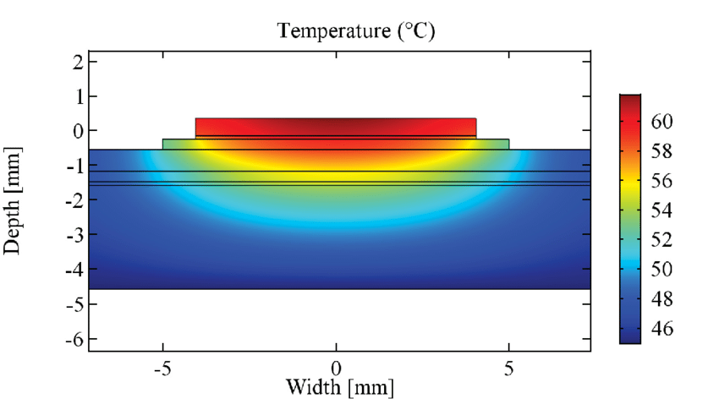




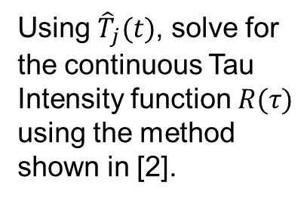




Postprocessing: Tau Intensity Calculation
Single Element
Step response
Equivalent circuit
${\hat{T}}_{j}\left(t\right)=R∗(1−e^{−\frac{t}{τ}} )$
$$τ=RC$$
Example diagram of heat flow through a power device
Lumped Element
Increasing Accuracy
Step response
Equivalent circuit
$${\hat{T}}_{j}\left(t\right)=\sum_{n=1}^{N}{R_{n}∗(1−e^{−\frac{t}{τ_{n}}} )}$$
$$1$$
$$2$$
$$N$$
Using ${\hat{T}}_{j}(t)$, solve for the continuous Tau Intensity function $R(τ)$ using the method shown in [2].
Continuous
Step response
Equivalent circuit
$${\hat{T}}_{j}\left(t\right)=\int_{0}^{∞}{R\left(τ\right)∗\left(1−e^{−\frac{t}{τ}}\right)dτ}$$
$$N=∞$$

Slide 14
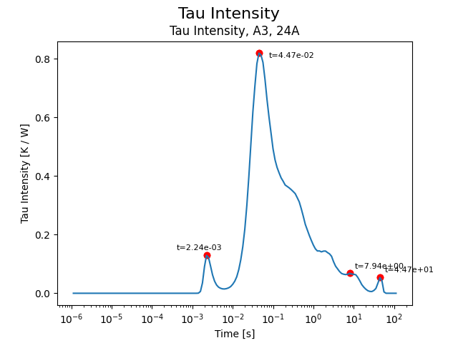

Postprocessing: Tau Peak Identification
Purpose of Tau Intensity
The first tau peak (2.24 ms) corresponds to the first material junction from the chip to the solder layer
The time constant peak gives an indication on when the Zth curve should be sampled.
Sample too early ($t<\sim 0.5τ$) and the heat flux through the solder layer will be too weak. Sample too late ($t>\sim 8τ$) and there will be increased variance due to the heat flux through the coldplate interface.

Slide 15
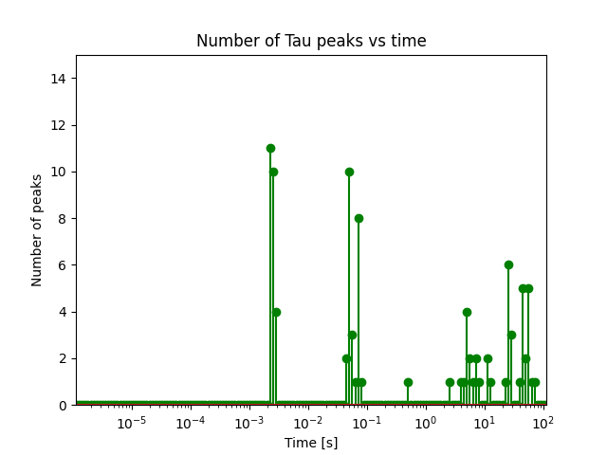
Results: First Tau Peak Distribution

Slide 16
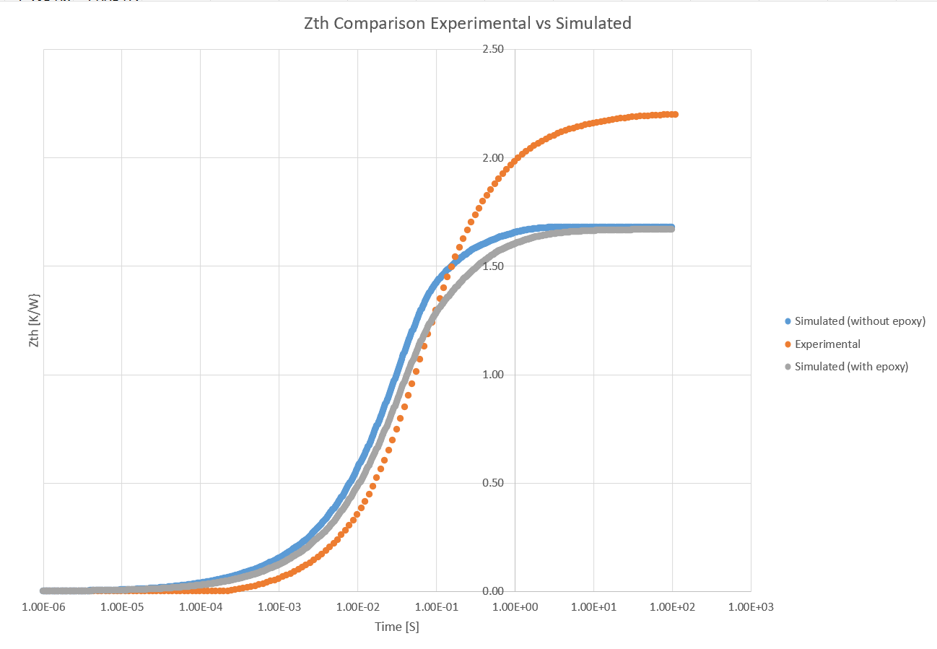
Results: Zth(t)

Slide 17
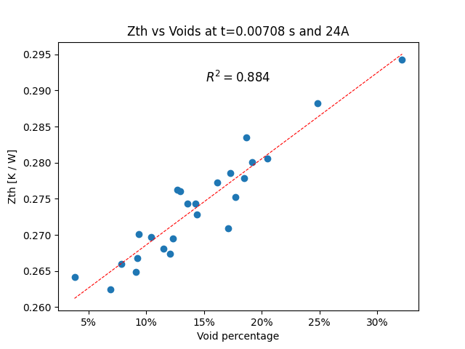
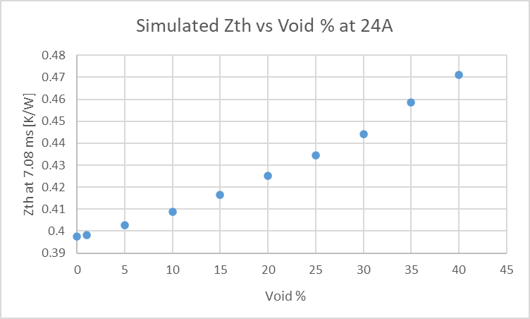
Results: Zth(t) for t = 7 ms
Experimental, Linear fit
Simulated

Slide 18
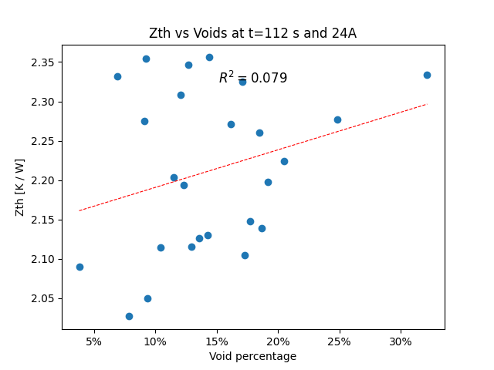
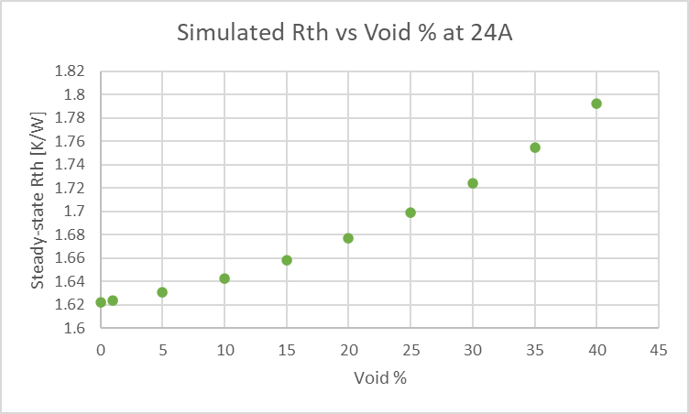
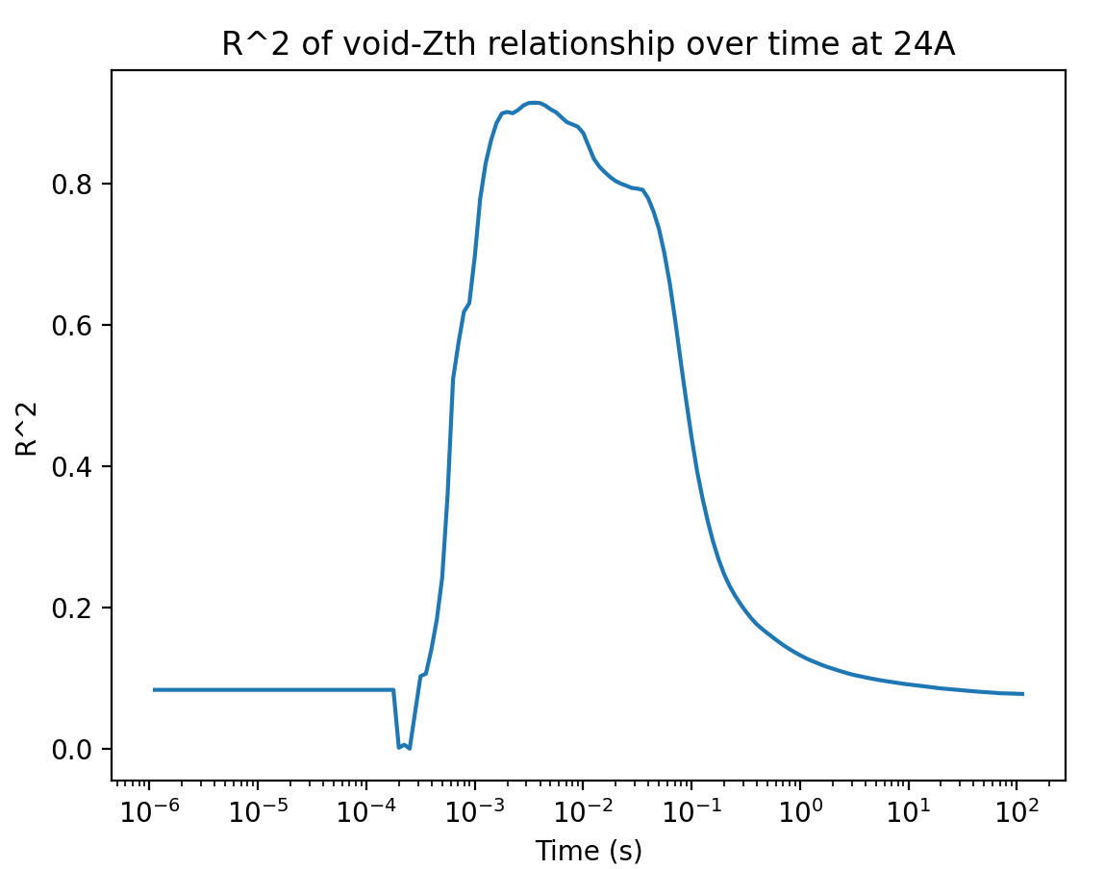
Results: Zth(t) Correlation at Non-Peak Times
Experimental
Simulated
What does Zth look like near steady-state?
At what time does the void percentage have the highest correlation with Zth?
Strongest correlation in the range of 1 – 5 multiples of the time constant

Slide 19
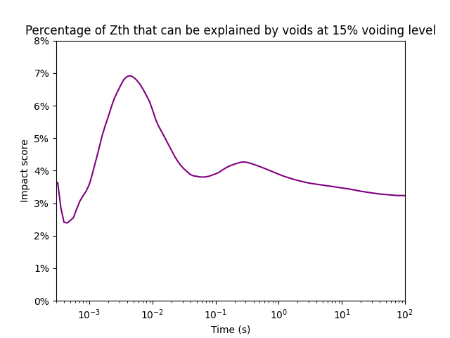
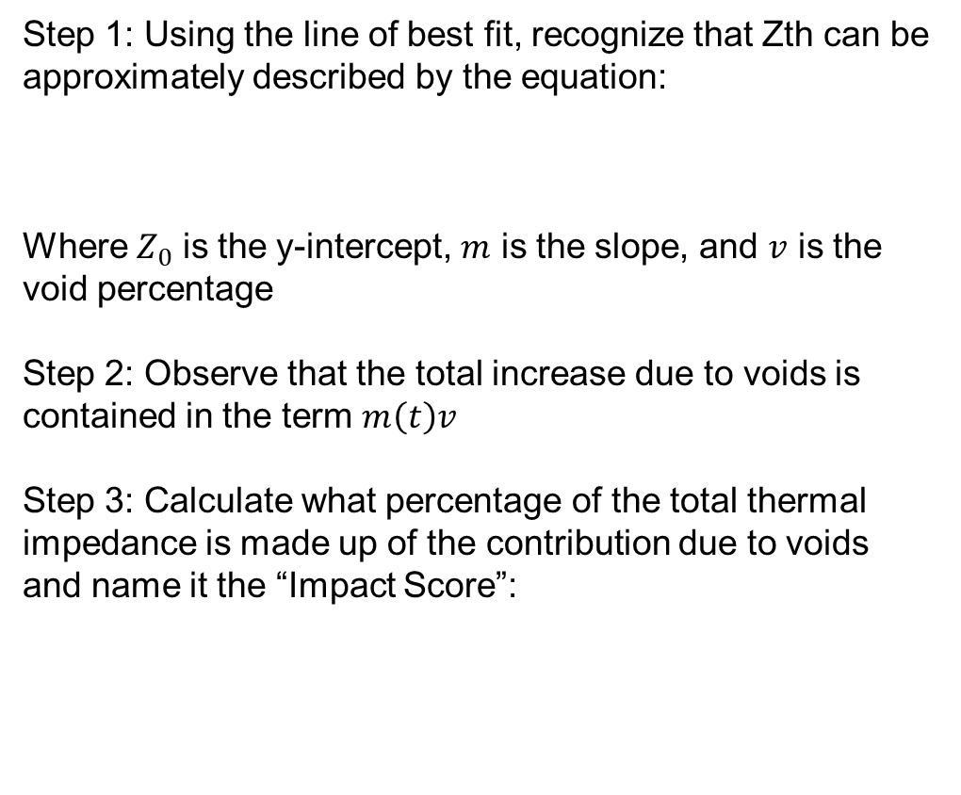
Results: Impact Score
Step 1: Using the line of best fit, recognize that Zth can be approximately described by the equation:
$Z_{total}\left(t\right)=Z_{0}\left(t\right)+m\left(t\right)v$
Where $Z_{0}$ is the y-intercept, $m$ is the slope, and $v$ is the void percentage
Step 2: Observe that the total increase due to voids is contained in the term $m\left(t\right)v$
Step 3: Calculate what percentage of the total thermal impedance is made up of the contribution due to voids and name it the “Impact Score”:
$$Impact Score=100\% ×\frac{m\left(t\right)v}{Z_{total}(t)}$$

Slide 20
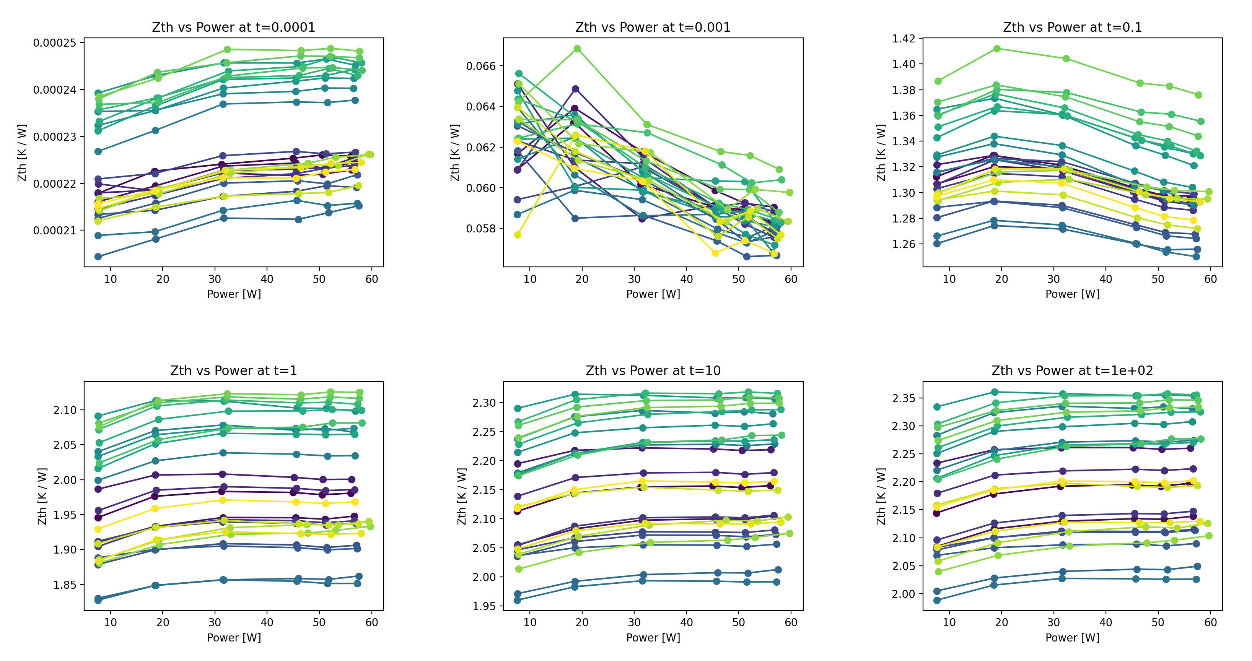
Results: Is the Thermal System Truly Linear?

Slide 21
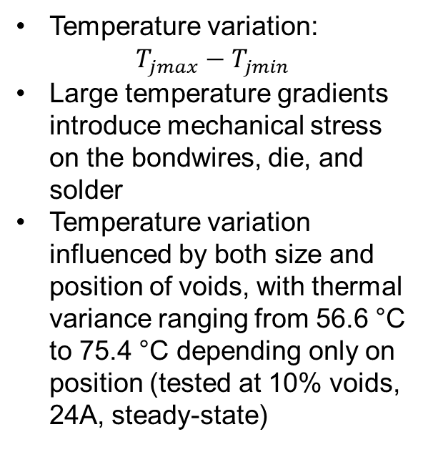
Finite-Element Temperature Variation
Temperature variation:
$$T_{jmax}−T_{jmin}$$
Large temperature gradients introduce mechanical stress on the bondwires, die, and solder
Temperature variation influenced by both size and position of voids, with thermal variance ranging from 56.6 °C to 75.4 °C depending only on position (tested at 10% voids, 24A, steady-state)

Slide 22
Part 2:
Reliability Testing

Slide 23

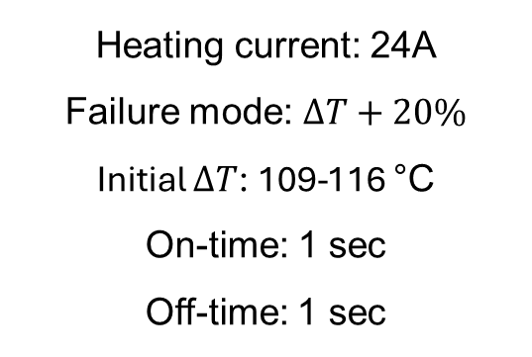
Power Cycling Test Description
Main Idea
Cycling Conditions:
Observe how solder voids affect the module’s ability to resist thermomechanical fatigue
Heating current: 24A
Failure mode: $∆T+20\%$
Initial $∆T$: 109-116 °C
On-time: 1 sec
Off-time: 1 sec
Purpose
Power modules often experience large temperature swings $∆T_{j}$ during operation

Slide 24

Solder Layer Degradation vs Bondwire Liftoff
We need the solder layer to fail first in order for the test to be accurate
How do we know this is the case?
Another common cause of failure is Bond wire liftoff, where the surface wire connections fall off
If this were to be the cause of failure, there would be sudden jumps in the on-state voltage due to an instantaneous change in electric resistance [3]
This is not the case
Forward Voltage During Power Cycling

Slide 25
Power Cycling Results

Slide 26
Part 3:
Fatigue Damage

Slide 27
Electron Microscope Setup
Test Setup
Microscope Setup
Compare a new package to one that had been subjected to thermal cycling. Take a cross-section of each chip and image the solder layer using SEM.
Device used: Thermo Scientific Axia ChemiSEM
Accelerating voltage: 20 kV
Main detectors used: Concentric Backscatter Detector (CBS)
What We are Looking For
Cracks in the solder layer and where they form
What the voids look like before vs after cycling
Potential delamination in the PCB
Void shape and size in the non-cycled version

Slide 28

Healthy Sample

Slide 29
Healthy Sample

Slide 30
Cycled Sample

Slide 31



Cycled Sample

Slide 32
Cycled Sample

Slide 33


X-ray Images
Before
After

Slide 34


Finite-Element Stress Simulation
Solder Layer Von Mieses Stress (20% void, 24A, steady-state)
Solder Layer Von Mieses Stress (0% void, 24A, steady-state)
Stress model did not include aging effects, a more accurate model for solder is Anand’s Visco-plastic model

Slide 35

Part 4:
Discussion and Conclusions

Slide 36
Review of Time Constant Technique
Good
Bad
Provides a consistent sampling time through the peak locations
Time constant matches well with times in which the thermal impedance is most related to solder layer
Implicitly uses a 1-D assumption of heat flow
Uses the foster network interpretation
Future Idea
Use 3-D differential equations to develop a timing method which accounts for heat spreading (not Foster or Cauer)

Slide 37

Void Impact on Zth
?
While voids definitely have an effect on thermal impedance, the total numerical change is relatively minor

Slide 38
Power Cycling Overview
Voids had a much greater impact on power cycling, where an increase of 15% of voids cut the lifetime in half

Slide 39

Damage Analysis
Voids Appear to facilitate crack formation

Slide 40
Conclusion
The main drawback of voids is that they reduce the fatigue resistance of the device. The thermal impact of voids is relatively minor.
Exceptions to this rule:
Applications which demand the module to withstand extremely fast transitions in power dissipation
Applications where the thermal resistance is already designed to be ultra-low, so the effect of solder voids is more pronounced

Slide 41
Future Work
Processing / Computational
Experimental
Include Anand’s Visco-plastic Model
Change the package geometry and materials. See if the time constant peak can still be picked out as easily, and if the new package has a different impact score.

Slide 42
Acknowledgements
References
[1] J. Yang, "Study on solder void for PiP large solder area ultrathin die in solder reflow," 2019 20th International Conference on Electronic Packaging Technology(ICEPT), Hong Kong, China, 2019, pp. 1-4, doi: 10.1109/ICEPT47577.2019.245265.
[2] V. Székely and T. Van Bien, “FINE STRUCTURE OF HEAT FLOW PATH IN SEMICONDUCTOR DEVICES: A MEASUREMENT AND IDENTIFICATION METHOD,” Solid State Electron, vol. 31, no. 9, pp. 1363–1368, 1988.
[3] J. Lehmann, M. Netzel, R. Herzer and S. Pawel, "Method for electrical detection of bond wire lift-off for power semiconductors," ISPSD '03. 2003 IEEE 15th International Symposium on Power Semiconductor Devices and ICs, 2003. Proceedings., Cambridge, UK, 2003, pp. 333-336, doi: 10.1109/ISPSD.2003.1225295.
Dr. Nicholas Baker
Dr. Andy Mackie and Christine LaBarbera for help with SEM!
Questions?

